Slide 1

COURSE PROJECT
CSIDNet: Compact Single Image Dehazing Network
For Outdoor Scene Enhancement using Deep Learning
Course: Image Processing with Machine Learning(IPML) (DA 526)
Based on Research by Teena Sharma, Isha Agrawal, & Nishchal K. Verma
Group Members : Shreyansh Gupta & Partha Sarathi Roychaudhuri
IP & ML Class Project
Slide 1

Slide 2

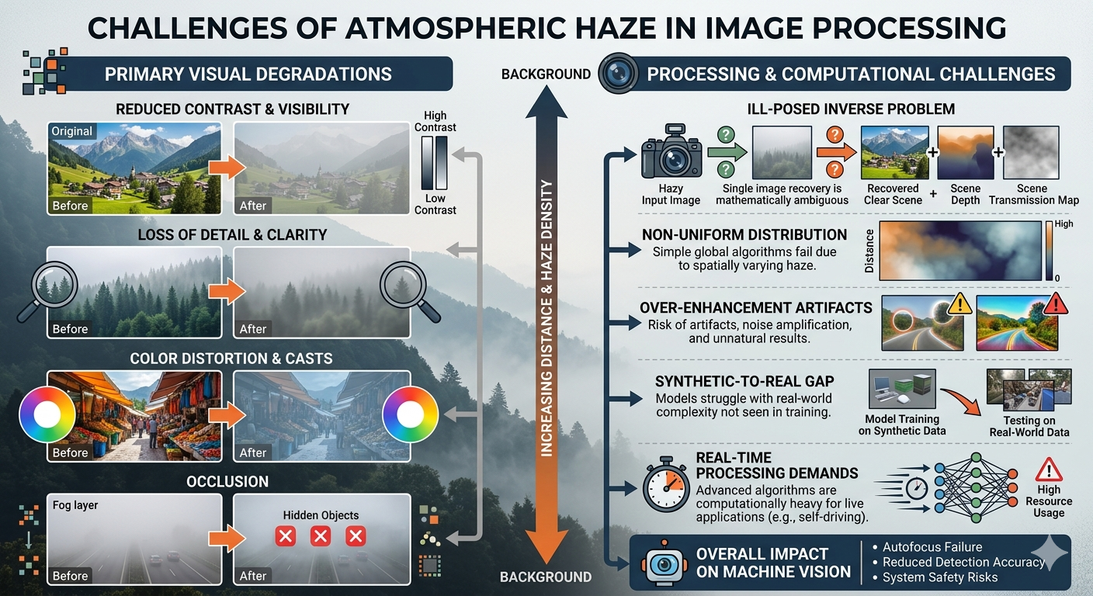

THE CHALLENGES OF ATMOSPHERIC HAZE
Non-Linear Noise
Vision Impact
Obscures clarity for critical tasks: Autonomous driving, Object Tracking, and Remote Sensing.
Haze is signal-dependent noise that attenuates pixel intensity based on scene depth.
Single Image Limitation
Unlike multi-image methods, single image dehazing lacks depth information, making it ill-posed and challenging.
Slide 2

Slide 3

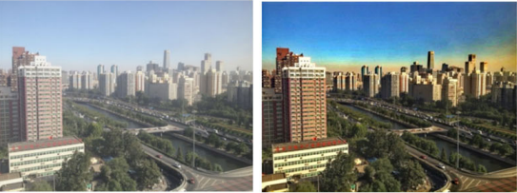
EVOLUTION OF DEHAZING METHODS
Dark Channel Prior (DCP): Based on the statistical observation that local patches in haze-free images have low intensity in at least one channel.
Boundary Constraint and Contextual Regularization(BCCR): Based on the assumption that haze-free images have better contrast than hazy ones.
Color Attenuation Prior: Calculate the scene depth and then estimated the transmission map.However, it is not always accurate, and further calculation of airlight using this leads to accumulation and amplification of error
Deep Learning: Transition from manual priors to learned features (DehazeNet, ,MSCNN, AOD-Net).
Current Limitations: High computational cost and requirement of massive datasets (millions of images).
Related Work
Slide 3

Slide 4
PROPOSED INNOVATION: CSIDNET
3
Compact Architecture: Only three convolutional layers designed for real-time mobile/edge applications.
CONV LAYERS
Data Efficiency: Successfully trained on just 200 images without diminishing performance.
Run-time Mastery: Achieves faster inference than AOD-Net and DehazeNet.
CSIDNet Overview
Slide 4

Slide 5


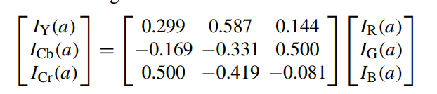
FEATURE ENGINEERING: PRIOR INTEGRATION
CSIDNet extracts a 5-channel feature tensor from the input hazy image by concatenating raw RGB with learned priors:
Dark Channel (Idark): Captures haze thickness via local minima.
Illumination (IY): Y-channel from YCbCr domain, highlighting haze-affected luminance.
Slide 5

Slide 6







PROCESSING PIPELINE
Pre-activation
Core Conv Layers
Skip Connection
Fully pre-activated stage with Batch Normalization (BN) and Leaky ReLU to stabilize initial gradients.
Layer 1 & 2: 16 filters (3x3 kernels). Layer 3: 5 output channels mapped to reconstruction space.
Global skip connection between input and output to preserve textural details and facilitate residual learning.
Architecture Part 2
Slide 6

Slide 7
TRAINING METHODOLOGY
Parameter | Setting / Value
Dataset | RESIDE - Outdoor Training Set (OTS)
Training Samples | 1000 randomly selected images
Optimizer | Adam (β1 = 0.9, β2 = 0.999)
Loss Function | Hybrid Error
Epochs / Iterations | 100 Iterations
Training Time | ~45 Minutes (Colab T4 GPU)
Slide 7

Slide 8
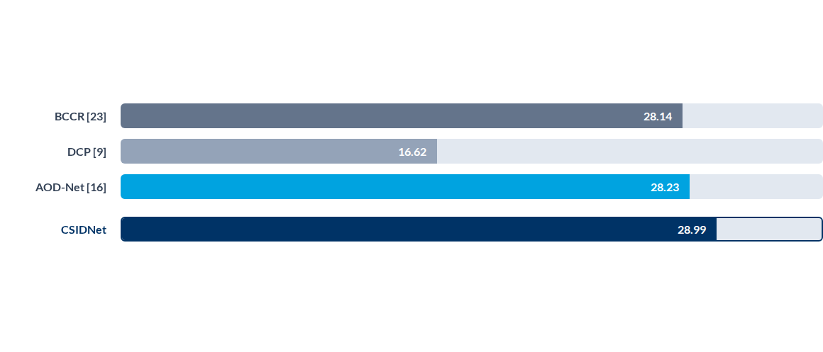
QUANTITATIVE BENCHMARKING
Peak Signal to Noise Ratio (PSNR) on SOTS Dataset
CSIDNET Performs better without relying on a heavier architecture supporting single image dehazing with much faster inference time
Slide 8

Slide 9
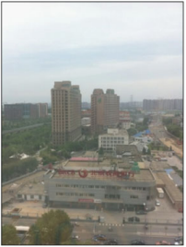
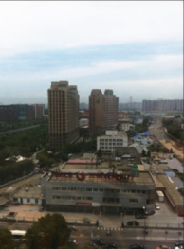



VISUAL COMPARISON RESULTS
Original Image
CSIDNet Restoration
Color Fidelity: CSIDNet maintains original chromatic information without the over-saturation common in CAP or BCCR.
Edge Preservation: Visual comparison shows sharper edge maintenance compared to AOD-Net blurring.
Original Hazy Input

Slide 10


Any Questions?
Project Conclusions:
CSIDNet effectively bridges the gap between processing speed and accuracy.
Compact 3-layer design is ideal for real-time video dehazing.
Residual learning with DCP priors enables high fidelity with minimal parameters.
Final Slide
Slide 10

